Slide 1
Pt20Au80_AgBP2_hollow_shell_XA>XAP
2023-09-18

Slide 2
Input Parameters for DecomNano
Input Parameters (All) 2589 data
Input Parameters (Droped parameters with no answer) 2589 data
Parameter | Min | Max | Mean | Standard Deviation
dP | 2.8 | 2.8 | 2.8 | 0.0
dA | 2.9 | 2.9 | 2.9 | 0.0
fA | 0.8 | 0.8 | 0.8 | 0.0
nAA | 7.0 | 8.0 | 7.5 | 0.3
nPP | 10.7 | 11.5 | 10.9 | 0.2
nAP | 0.2 | 1.4 | 0.7 | 0.2
nPA | 0.3 | 1.1 | 0.5 | 0.2
DA | 16 | 28 | 21.3 | 2.3
DAP | 40 | 40 | 40.0 | 0.0
DP | 0 | 36 | 13.2 | 11.3
DAPh | 0 | 20 | 7.2 | 6.2
Parameter | Min | Max | Mean | Standard Deviation
dP | 2.8 | 2.8 | 2.8 | 0.0
dA | 2.9 | 2.9 | 2.9 | 0.0
fA | 0.8 | 0.8 | 0.8 | 0.0
nAA | 7.0 | 8.0 | 7.5 | 0.3
nPP | 10.7 | 11.5 | 10.9 | 0.2
nAP | 0.2 | 1.4 | 0.7 | 0.2
nPA | 0.3 | 1.1 | 0.5 | 0.2
DA | 16 | 28 | 21.3 | 2.3
DAP | 40 | 40 | 40.0 | 0.0
DP | 0 | 36 | 13.2 | 11.3
DAPh | 0 | 20 | 7.2 | 6.2

Slide 3
Ouput Parameters
Parameter | Min | Max | Mean | Standard Deviation
dP | 2.8 | 2.8 | 2.8 | 0.0
dA | 2.9 | 2.9 | 2.9 | 0.0
fA | 0.8 | 0.8 | 0.8 | 0.0
nAA | 7.0 | 8.0 | 7.5 | 0.3
nPP | 10.7 | 11.5 | 10.9 | 0.2
nAP | 0.2 | 1.4 | 0.7 | 0.2
nPA | 0.3 | 1.1 | 0.5 | 0.2
DA | 16 | 28 | 21.3 | 2.3
DAP | 40 | 40 | 40.0 | 0.0
DP | 0 | 36 | 13.2 | 11.3
DAPh | 0 | 20 | 7.2 | 6.2
nAM_AP | 1.6 | 7.9 | 5.4 | 1.3
nPM_AP | 11.0 | 12.0 | 11.6 | 0.3
nAA_AP | 0.0 | 6.3 | 3.2 | 1.6
nAP_AP | 0.8 | 4.4 | 2.3 | 0.8
nPA_AP | 0.3 | 1.3 | 0.6 | 0.2
nPP_AP | 10.7 | 11.7 | 11.1 | 0.2
XAP | 0.11 | 0.5 | 0.31 | 0.09
XA | 0.31 | 0.87 | 0.66 | 0.1
XP | 0.0 | 0.41 | 0.03 | 0.05
y | 0.09 | 0.43 | 0.2 | 0.06
dAP | 2.9 | 2.9 | 2.9 | 0.0
nMM_AP | 10.8 | 10.8 | 10.8 | 0.0
nAA_A | 9.3 | 10.3 | 9.9 | 0.2
nPP_P | 0.0 | 10.7 | 7.0 | 3.7
NA | 121.2 | 519.9 | 256.8 | 71.9
NP | 1.0 | 1150.6 | 221.2 | 336.0
NAP | 1413.8 | 1413.8 | 1413.8 | 0.0
XA*NA | 76.4 | 287.2 | 163.8 | 35.6
XP*NP | 0.0 | 471.9 | 15.9 | 46.7
XAP*NAP | 155.6 | 701.6 | 444.7 | 132.8
frac_XA*NA | 0.11 | 0.47 | 0.27 | 0.07
frac_XP*NP | 0.0 | 0.47 | 0.02 | 0.06
frac_XAP*NAP | 0.31 | 0.87 | 0.7 | 0.08
frac_Pt_P | 0.0 | 0.67 | 0.04 | 0.09
frac_Pt_PA | 0.33 | 1.0 | 0.96 | 0.09

Slide 4
Solution of DecomNano
Parameter | Min | Max | Mean | Standard Deviation
nAM_AP | 1.6 | 7.9 | 5.4 | 1.3
nPM_AP | 11.0 | 12.0 | 11.6 | 0.3
nAA_AP | 0.0 | 6.3 | 3.2 | 1.6
nAP_AP | 0.8 | 4.4 | 2.3 | 0.8
nPA_AP | 0.3 | 1.3 | 0.6 | 0.2
nPP_AP | 10.7 | 11.7 | 11.1 | 0.2
XAP | 0.11 | 0.5 | 0.31 | 0.09
XA | 0.31 | 0.87 | 0.66 | 0.1
XP | 0.0 | 0.41 | 0.03 | 0.05
y | 0.09 | 0.43 | 0.2 | 0.06

Slide 5
Other Parameters Calculated in the DecomNano
Parameter | Min | Max | Mean | Standard Deviation
dAP | 2.9 | 2.9 | 2.9 | 0.0
nMM_AP | 10.8 | 10.8 | 10.8 | 0.0
nAA_A | 9.3 | 10.3 | 9.9 | 0.2
nPP_P | 0.0 | 10.7 | 7.0 | 3.7
NA | 121.2 | 519.9 | 256.8 | 71.9
NP | 1.0 | 1150.6 | 221.2 | 336.0
NAP | 1413.8 | 1413.8 | 1413.8 | 0.0

Slide 6
Extracted Parameter Related to Hetereogeneity
Parameter | Min | Max | Mean | Standard Deviation
XA*NA | 76.4 | 287.2 | 163.8 | 35.6
XP*NP | 0.0 | 471.9 | 15.9 | 46.7
XAP*NAP | 155.6 | 701.6 | 444.7 | 132.8
y | 0.09 | 0.43 | 0.2 | 0.06
nAM_AP | 1.6 | 7.9 | 5.4 | 1.3
nPM_AP | 11.0 | 12.0 | 11.6 | 0.3

Slide 7
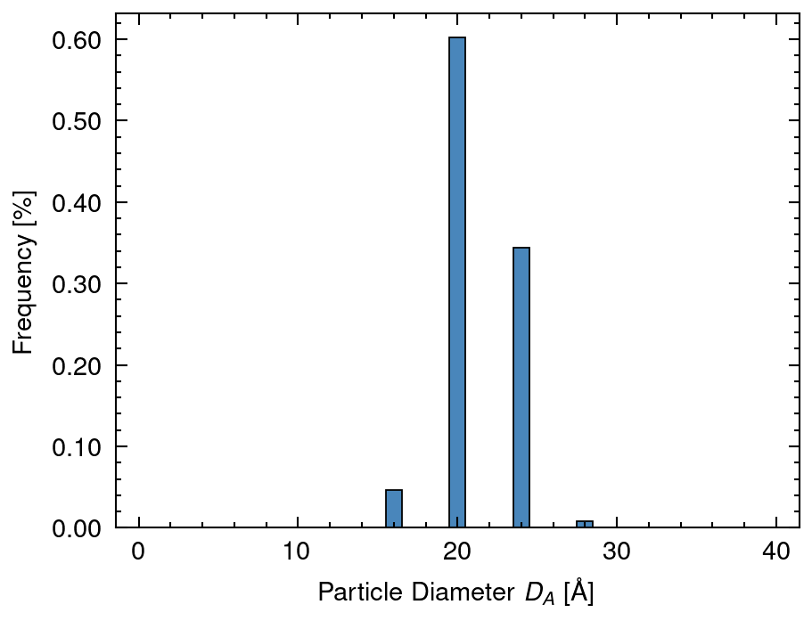
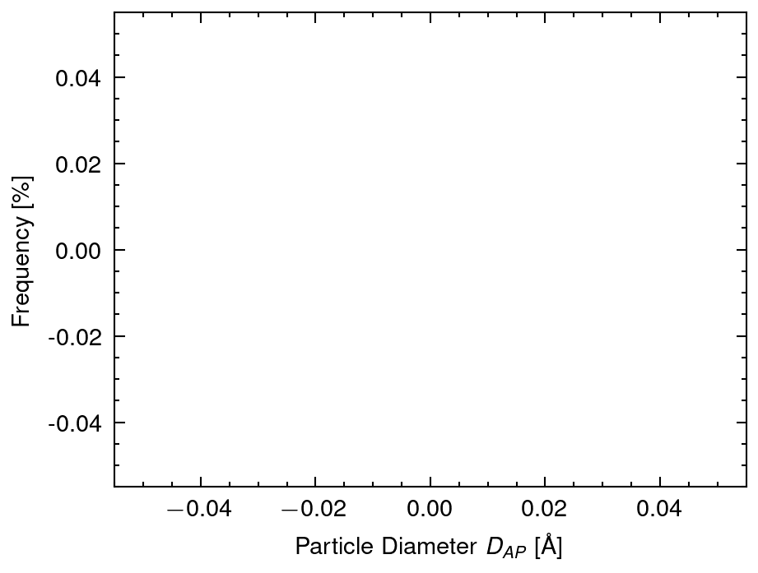
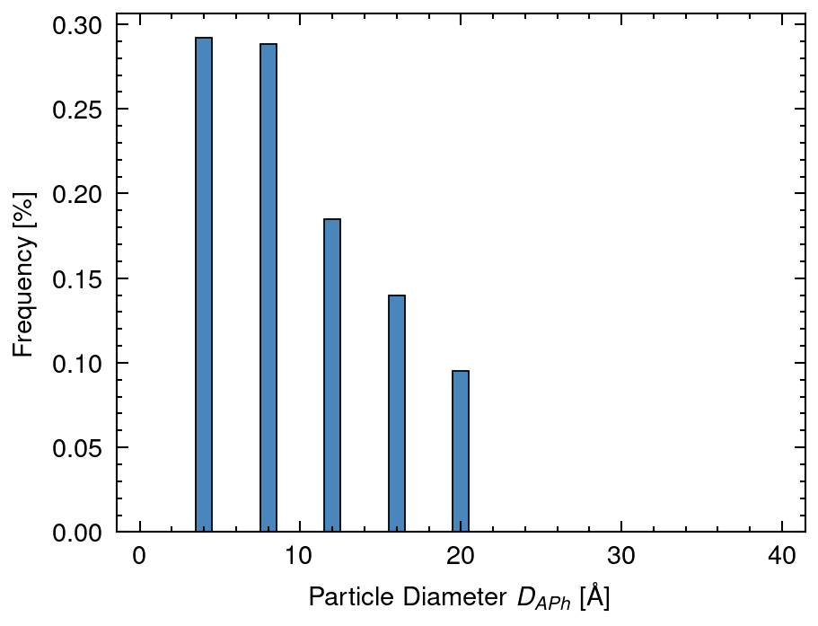
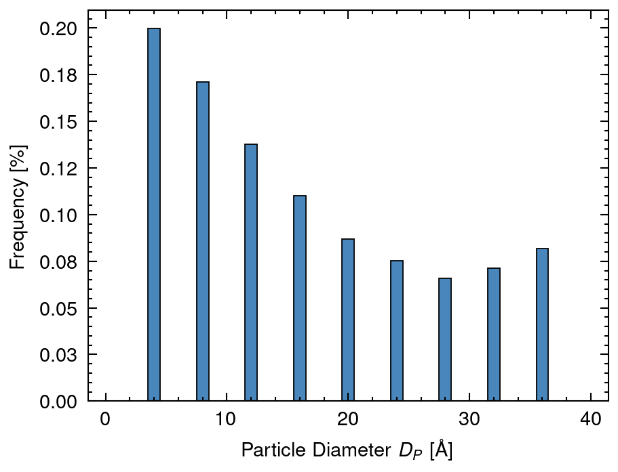
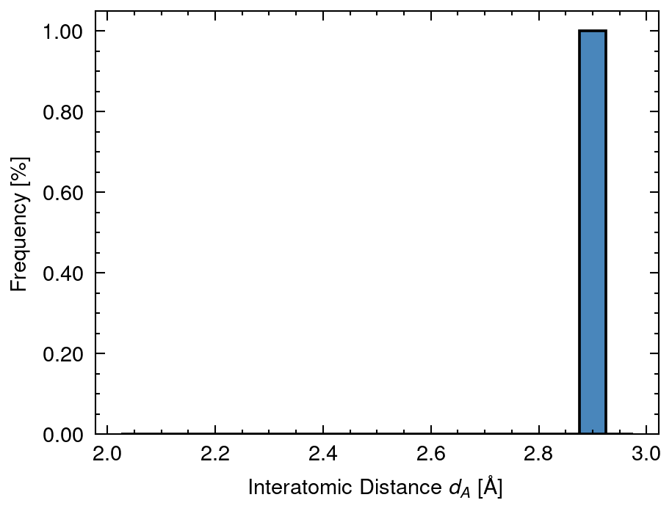
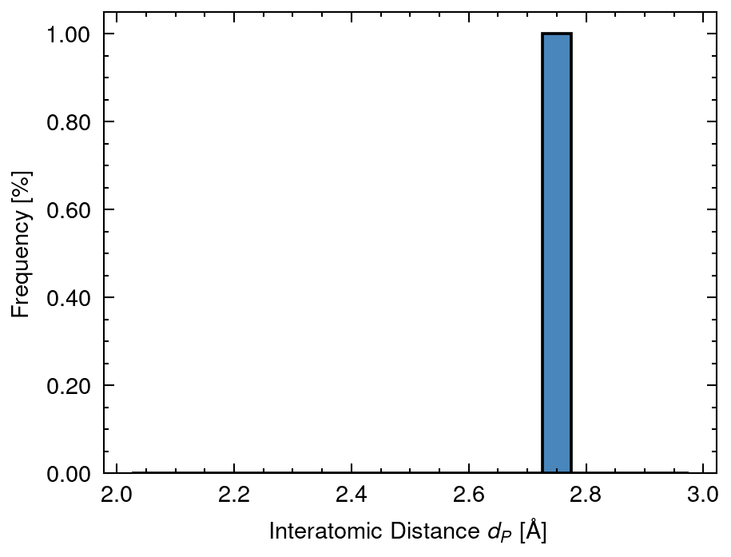
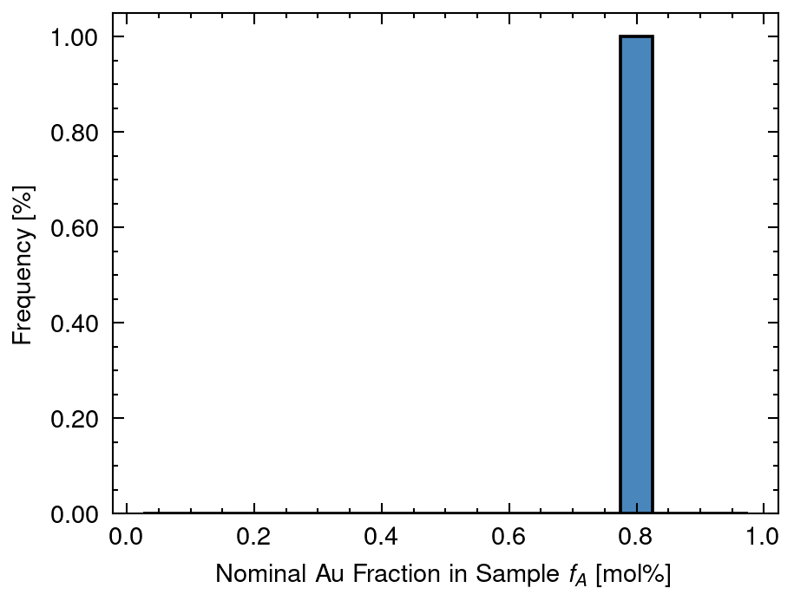
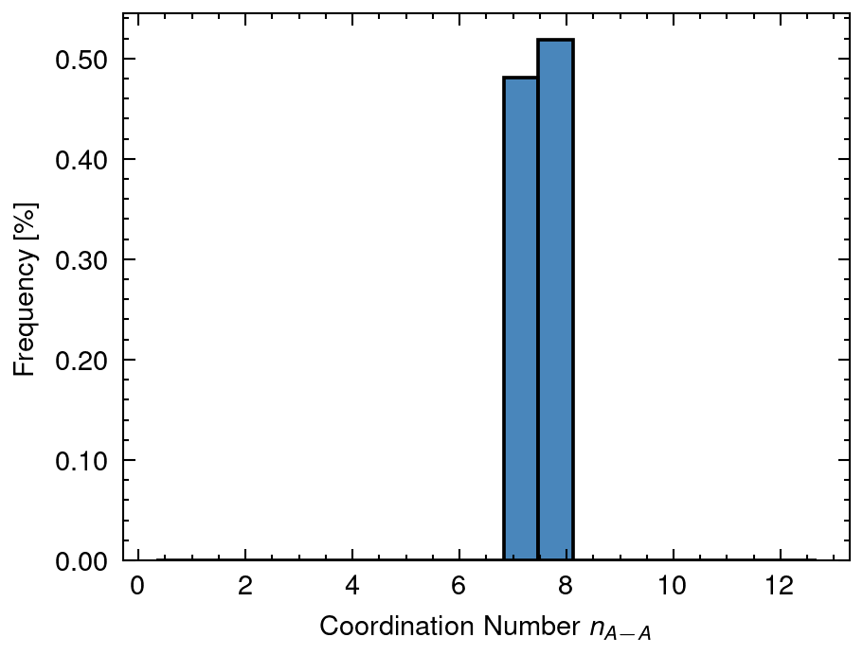
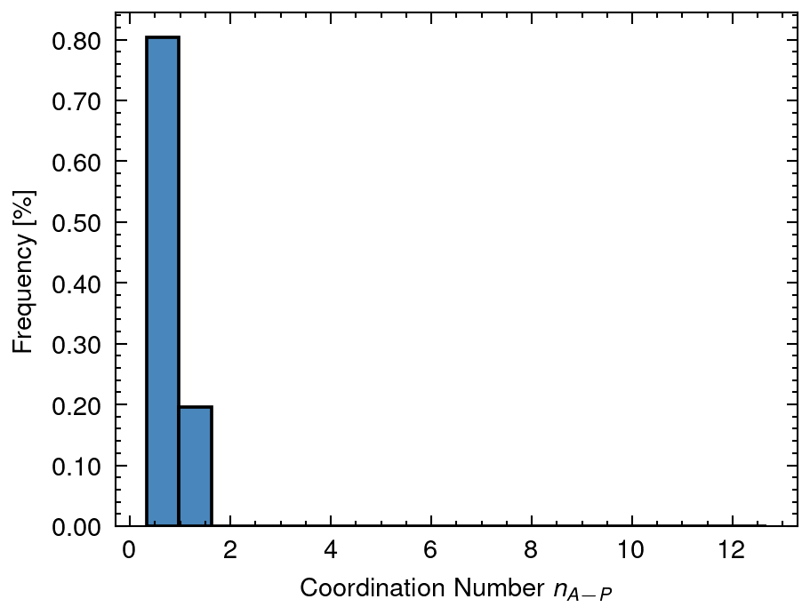
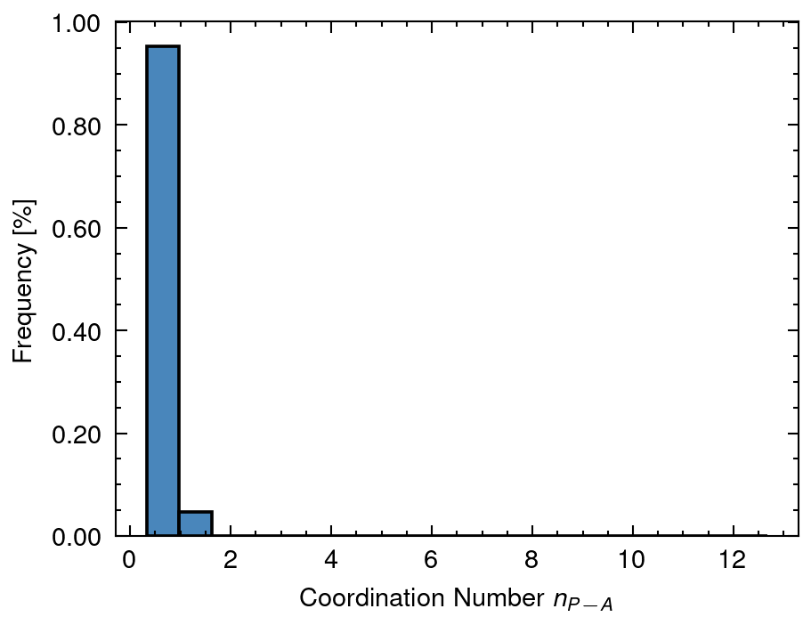
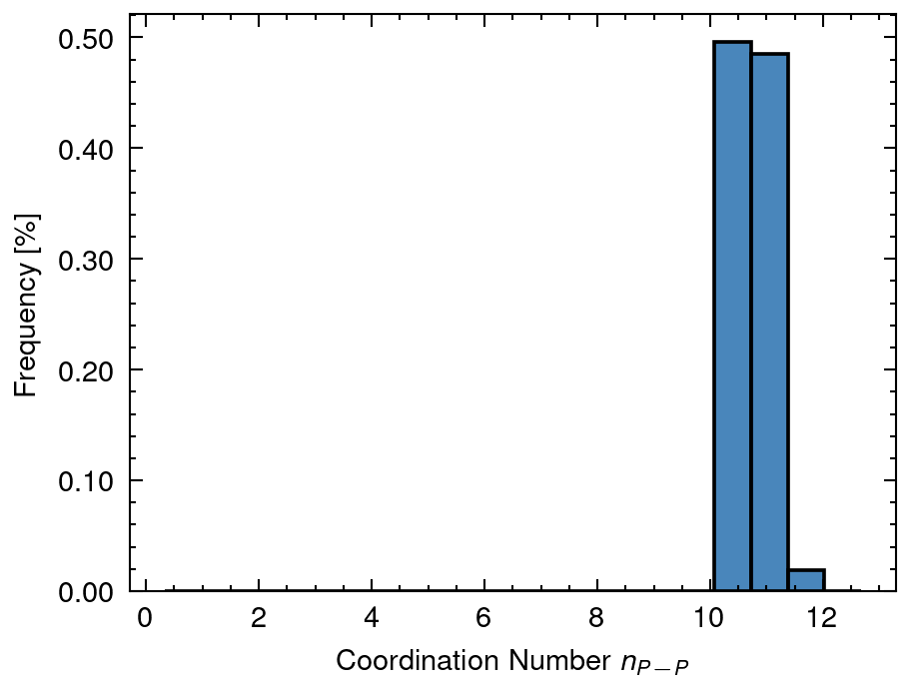
1 Distribution of input data
DA mean: 21.26 sd:2.28
DAP mean: 40.0 sd:0.0
DAPh mean: 7.17 sd:6.23
DP mean: 13.23 sd:11.31
dA mean: 2.88 sd:0.0
dP mean: 2.77 sd:0.0
fA mean: 0.8 sd:0.0
nAA mean: 7.52 sd:0.34
nAP mean: 0.69 sd:0.24
nPA mean: 0.51 sd:0.22
nPP mean: 10.87 sd:0.2

Slide 8
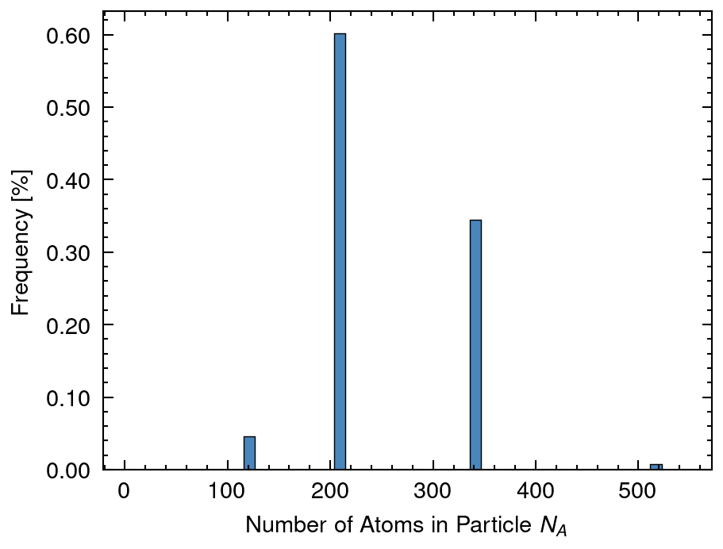
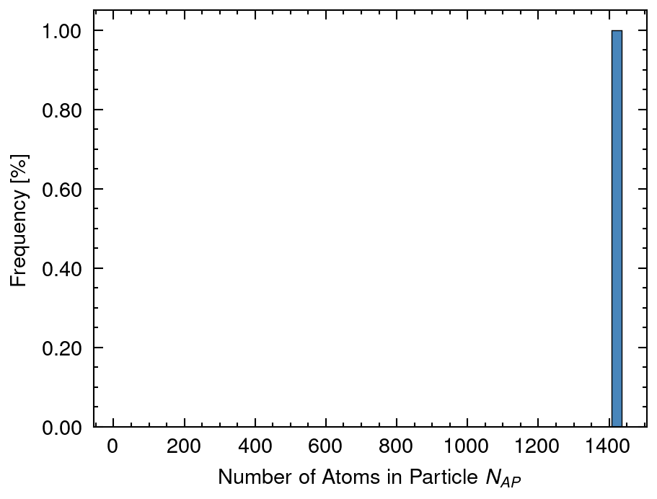
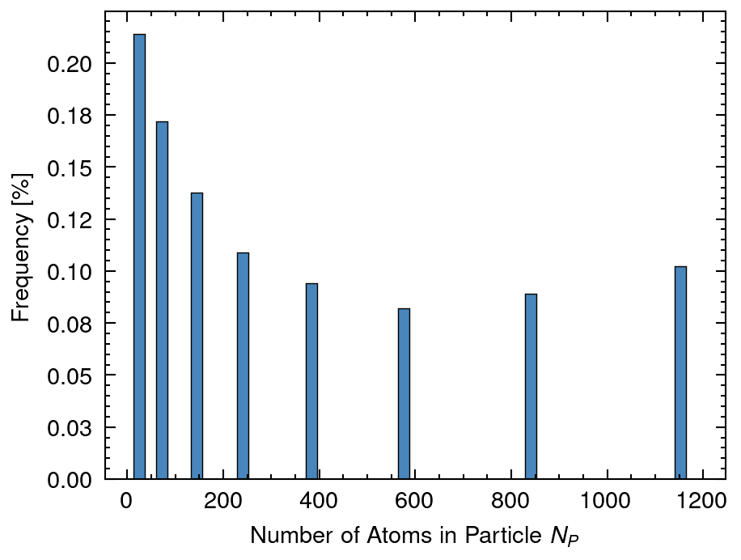
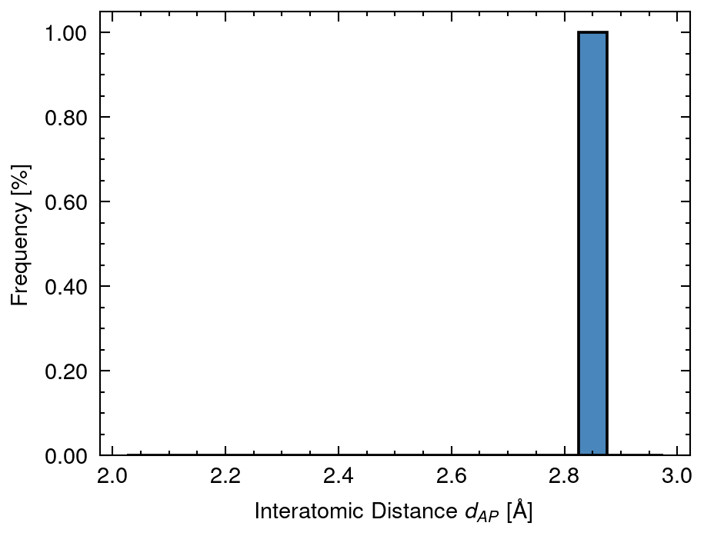
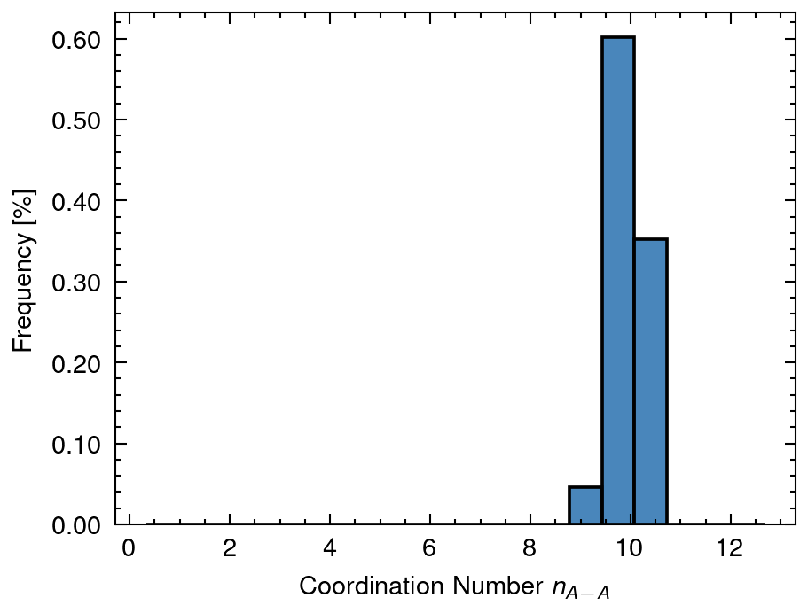

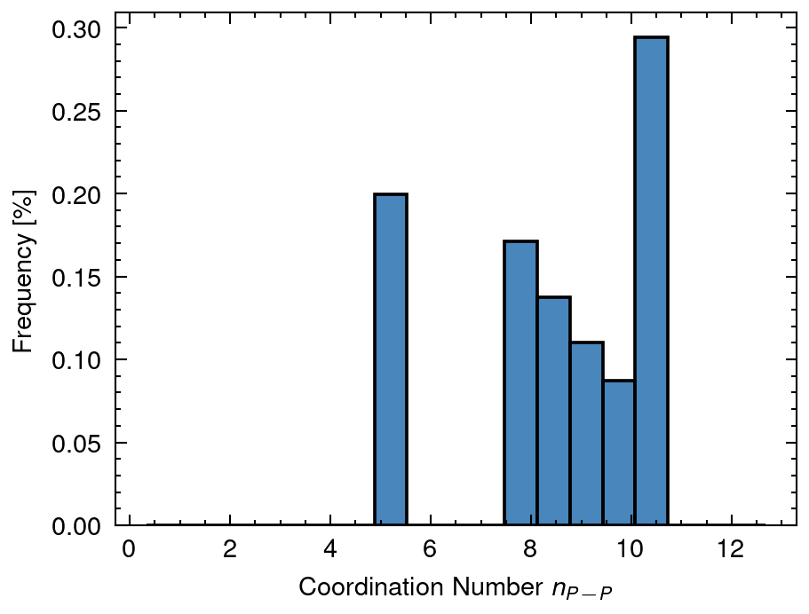
2 Distribution of calculated data
NA mean: 256.76 sd:71.86
NAP mean: 1413.82 sd:0.0
NP mean: 221.24 sd:336.02
dAP mean: 2.86 sd:0.0
nAA_A mean: 9.86 sd:0.2
nMM_AP mean: 10.8 sd:0.0
nPP_P mean: 6.99 sd:3.71

Slide 9
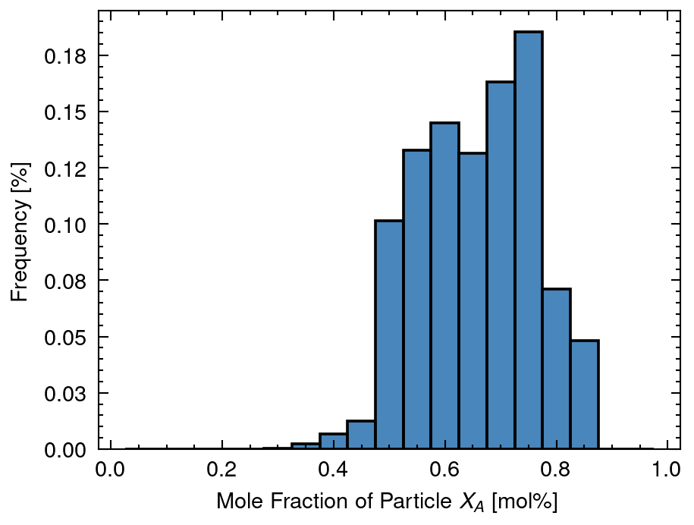
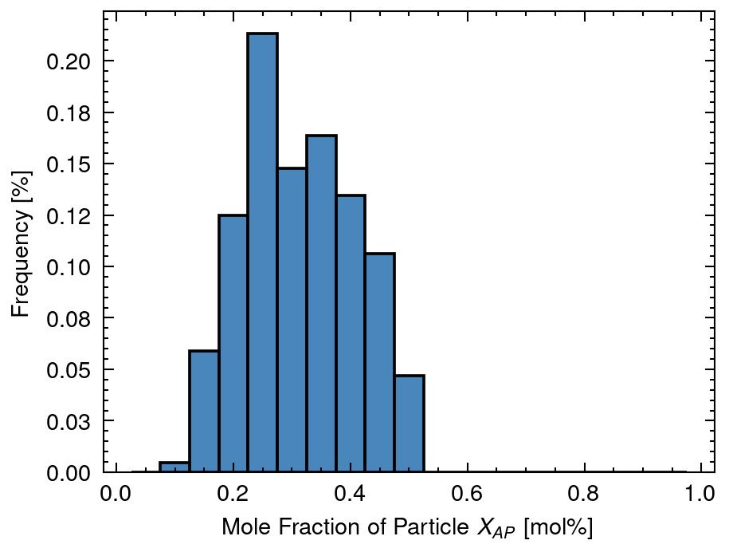
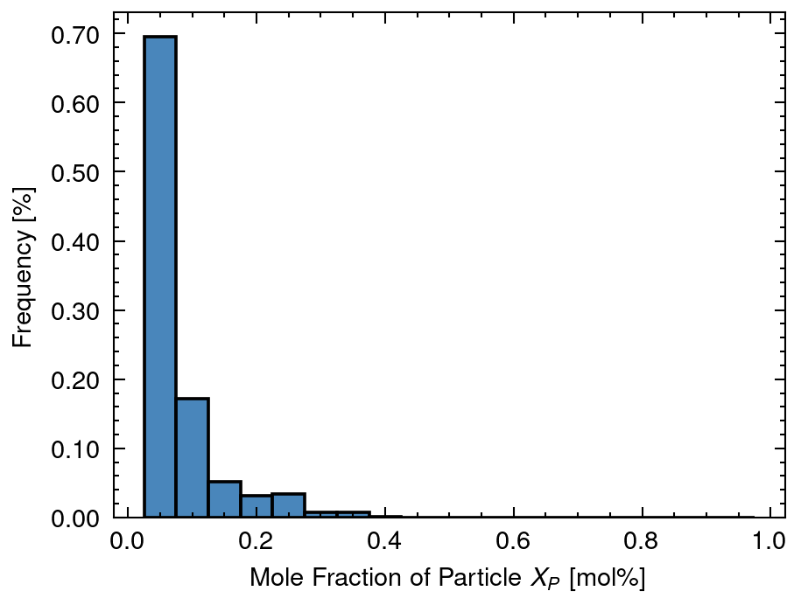
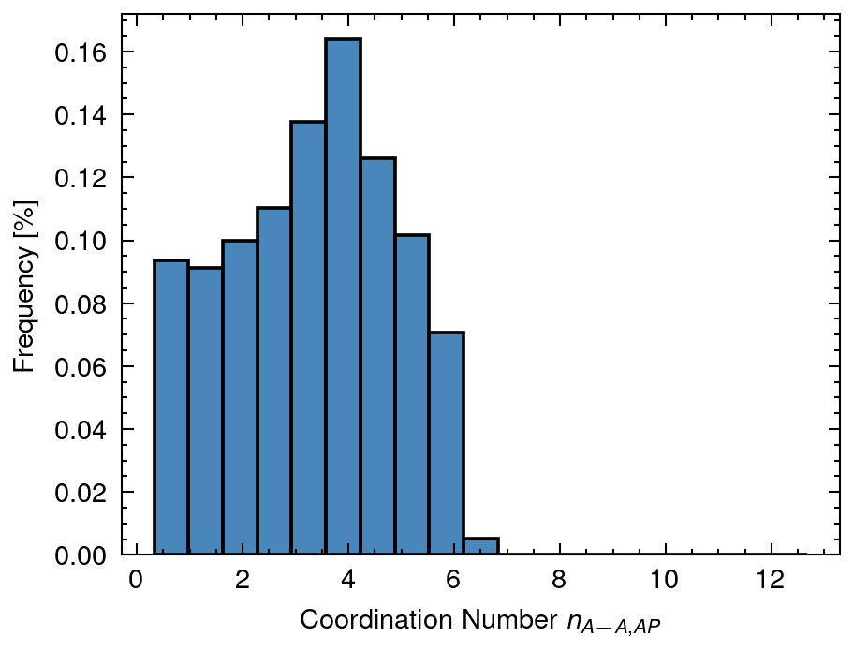
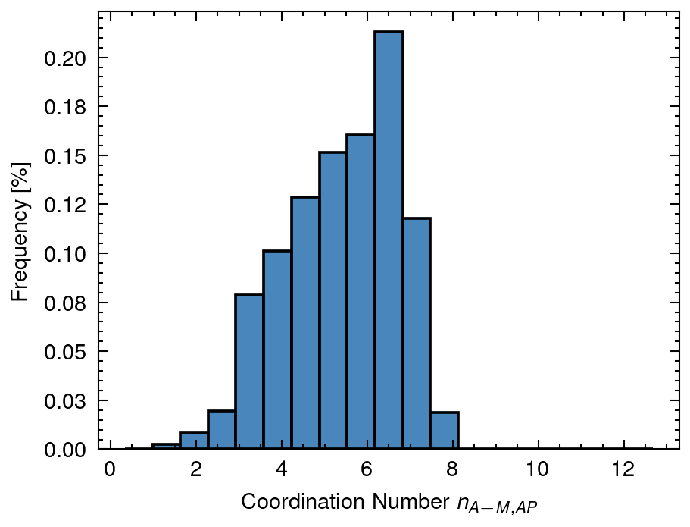
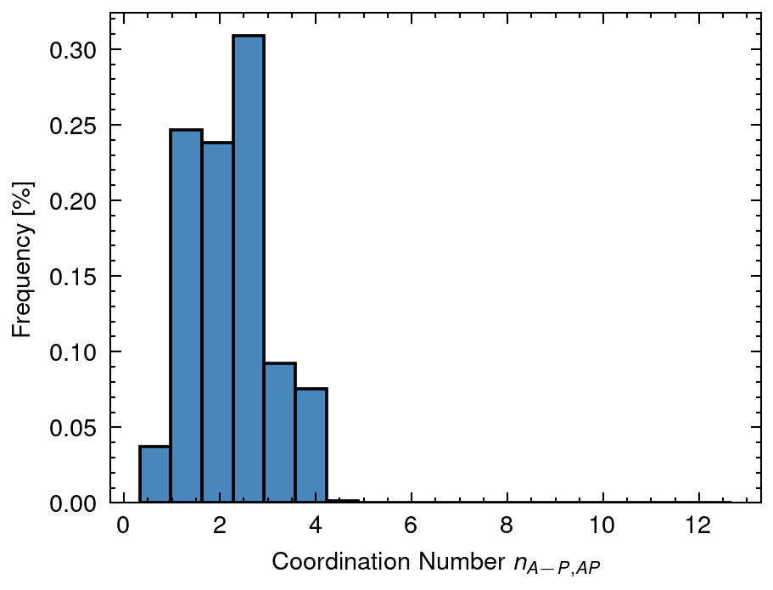
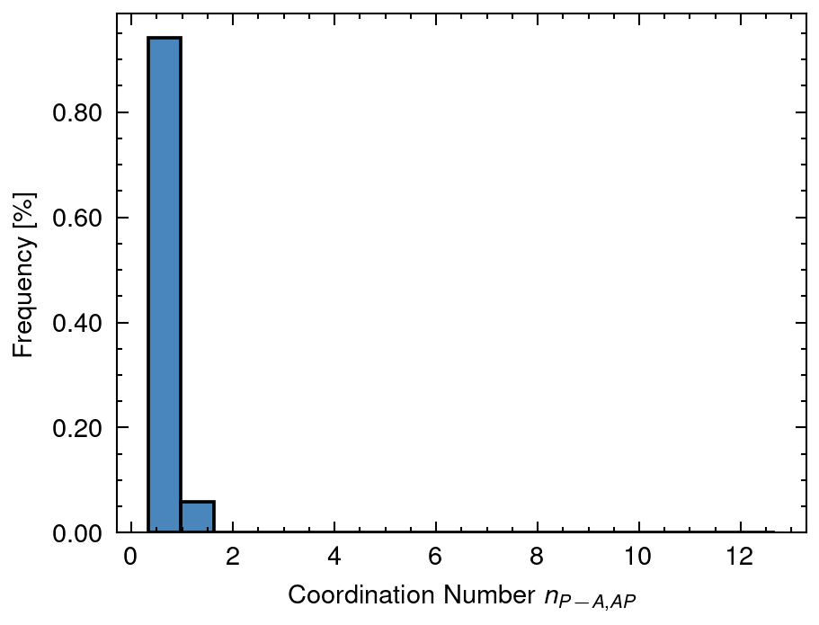
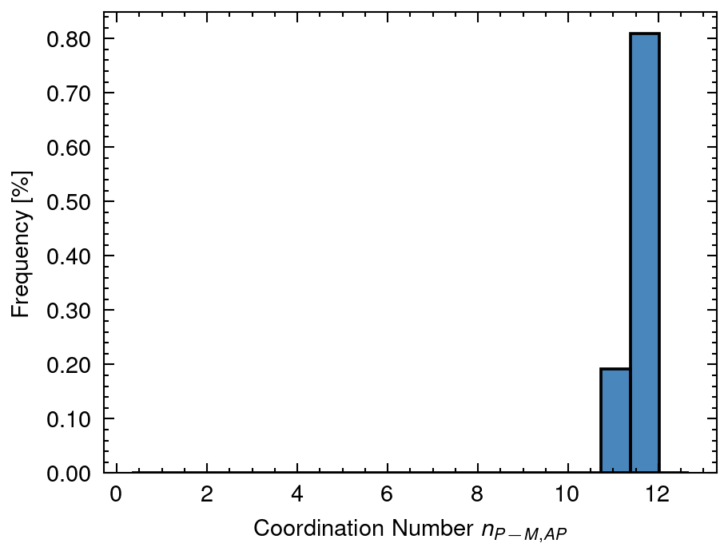
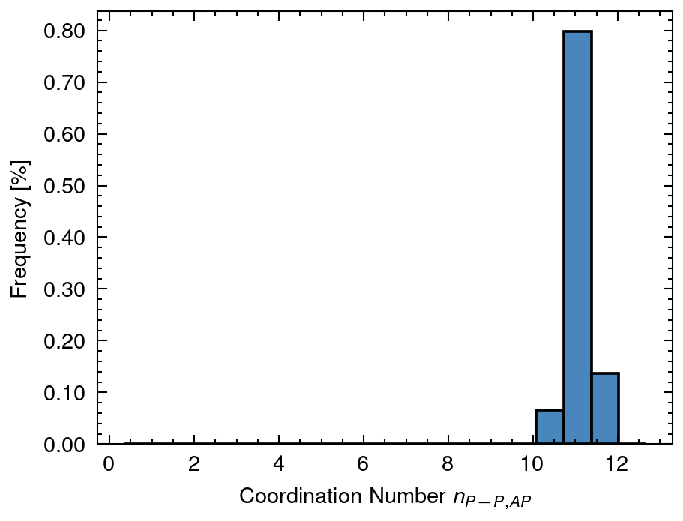
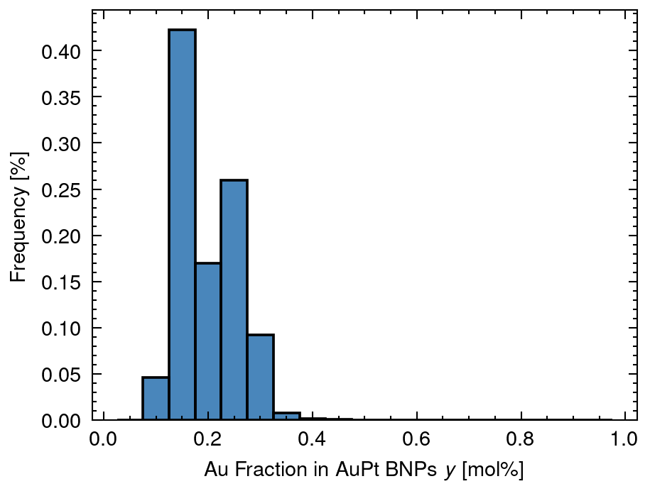
3 Distribution of solved data
XA mean: 0.66 sd:0.1
XAP mean: 0.31 sd:0.09
XP mean: 0.03 sd:0.05
nAA_AP mean: 3.16 sd:1.64
nAM_AP mean: 5.41 sd:1.31
nAP_AP mean: 2.25 sd:0.78
nPA_AP mean: 0.56 sd:0.23
nPM_AP mean: 11.62 sd:0.26
nPP_AP mean: 11.06 sd:0.25
y mean: 0.2 sd:0.06

Slide 10
4 Distribution of n (Overall Cordination Number)
nAA_A mean: 9.86 sd:0.2
nMM_AP mean: 10.8 sd:0.0
nPP_P mean: 6.99 sd:3.71

Slide 11
5 Distribution of X (Fraction of Nanoparticle)
XA mean: 0.66 sd:0.1
XAP mean: 0.31 sd:0.09
XP mean: 0.03 sd:0.05

Slide 12
6 Distribution of y (Fraction of Au in Nanoparticle)
y mean: 0.2 sd:0.06

Slide 13
7 Distribution of D (Diameter of Nanoparticle)
DA mean: 21.26 sd:2.28
DAP mean: 40.0 sd:0.0
DAPh mean: 7.17 sd:6.23
DP mean: 13.23 sd:11.31

Slide 14
8 Distribution of n (Coordination Number of Nanoparticle)
nAA_AP mean: 3.16 sd:1.64
nAM_AP mean: 5.41 sd:1.31
nAP_AP mean: 2.25 sd:0.78
nPA_AP mean: 0.56 sd:0.23
nPM_AP mean: 11.62 sd:0.26
nPP_AP mean: 11.06 sd:0.25

